Slide 1
2nd
Period
English Grade 6
Lesson 5
Lesson 5
(p76~77)

Slide 2
Let’s Review
What are you going to do
this afternoon?
I’m going to stay home.
What are you going to do
tomorrow?

Slide 3
Learning Point
계획을 묻고 답하는 말하기
전화 대화하기

Slide 4
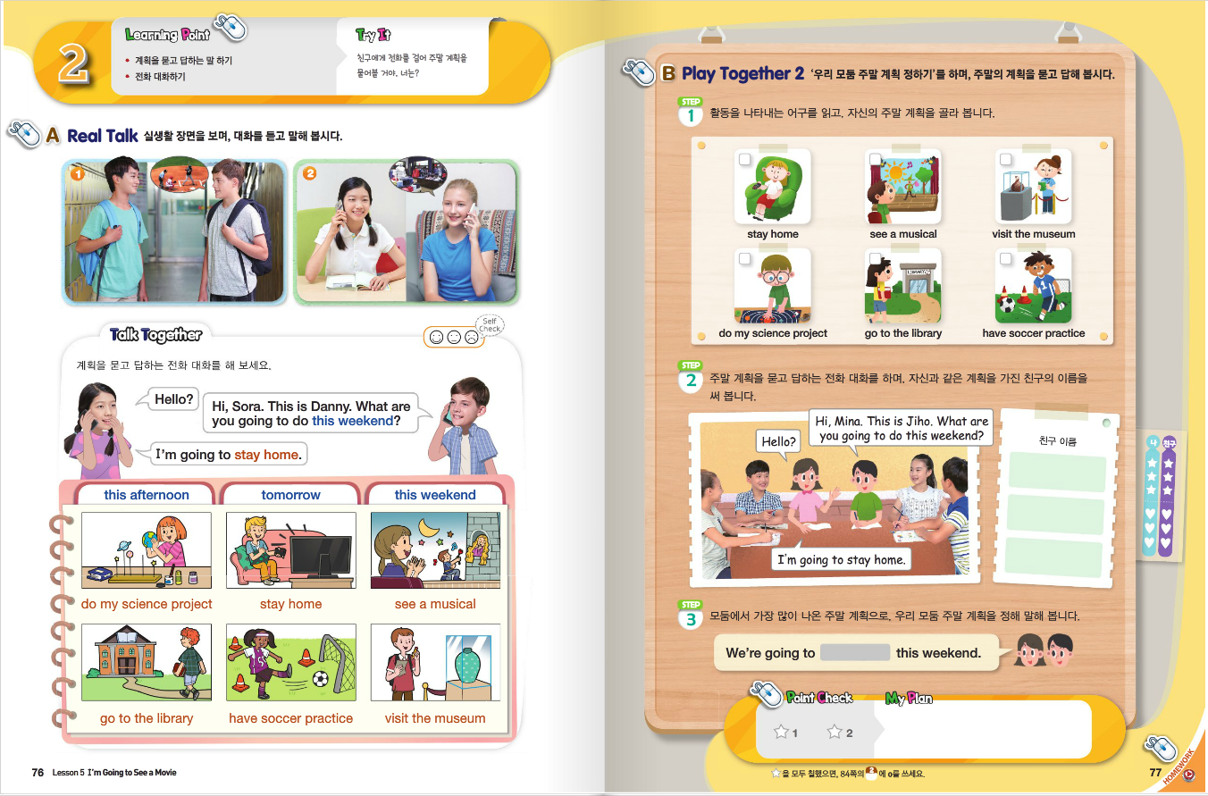

Slide 5
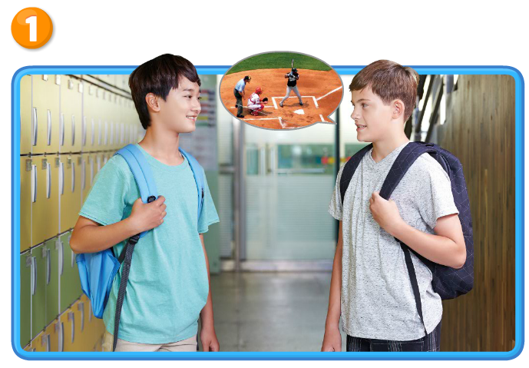
Real Talk #1

Slide 6
Real Talk1 Let’s Listen

Slide 7
Real Talk1 Let’s Listen Again

Slide 8
Listen and
Comprehend
What are you going to do
tomorrow?
Sounds great!
Nothing special.
Come to my house at three.
I’m going to stay home and watch TV.
Okay. See you tomorrow.
Let’s go to a baseball game.

Slide 9
Listen and
Repeat
What are you going to do
tomorrow?
Sounds great!
Nothing special.
Come to my house at three.
I’m going to stay home and watch TV.
Okay. See you tomorrow.
Let’s go to a baseball game.

Slide 10
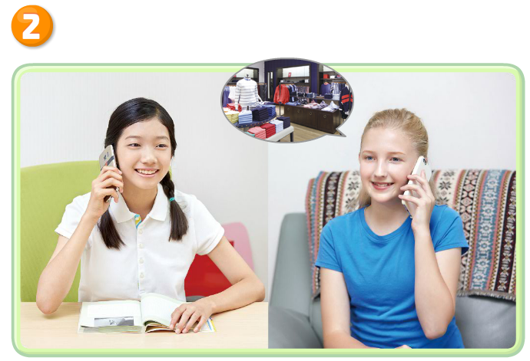
Real Talk #2

Slide 11
Real Talk2 Let’s Listen

Slide 12
Real Talk2 Let’s Listen Again

Slide 13
Listen and
Comprehend
I’m going to go shopping this afternoon.
Hello?
Great. Let’s meet at the bus stop at two.
Can you come with me?
Hi, Sora. This is Kelly.
Okay. See you later.
Sure. I need a T-shirt.
Hi, Kelly. What’s up?

Slide 14
Listen and Repeat
I’m going to go shopping this afternoon.
Hello?
Great. Let’s meet at the bus stop at two.
Can you come with me?
Hi, Sora. This is Kelly.
Okay. See you later.
Sure. I need a T-shirt.
Hi, Kelly. What’s up?

Slide 15
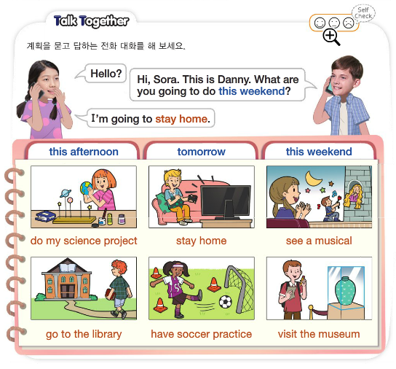
Talk Together

Slide 16
Talk Together

Slide 17
Talk Together

Slide 18
Point Check

Slide 19
Let’s Review
Hello?
Hi, Mina. This is Tom.
What are you going to do
tomorrow?
I’m going to do my science project.

Slide 20
Let’s Review

Slide 21
Your Work
Real Talk 다시 듣고 따라 말하기
Talk Together에 제시된 낱말과 어구
공책에 적어보기

Slide 22
이 영상에 사용한 교과서의 지문, 삽화, 음원, 영상 등
모든 교과서 자료는 (주)천재교육에 저작재산권이 있습니다.
이 영상의 저작재산권은 제작자에게 있습니다
이 영상은 각 초등학교에서 수업에 사용할 수 있습니다.
이 외의 방법과 목적으로 이 영상을 사용하거나
일부 또는 전부를 저장 장치에 저장하거나,
일부 또는 전부를 다른 자료에 사용하는 것은
저작권법에 위배될 수 있음을 알려드립니다.

