Slide 1
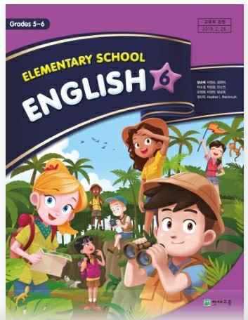
2nd
Period
English Grade 6
Lesson 6
Lesson 6
He Has Short Curly Hair.
(p90~91)

Slide 2
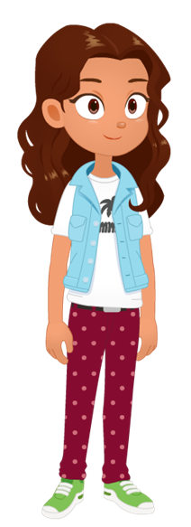
Let’s Review
What does she look like?
She has brown eyes and long curly hair.

Slide 3
Learning Point
외모를 묻고 답하는 말하기
옷차림을 묘사하는 말하기

Slide 4
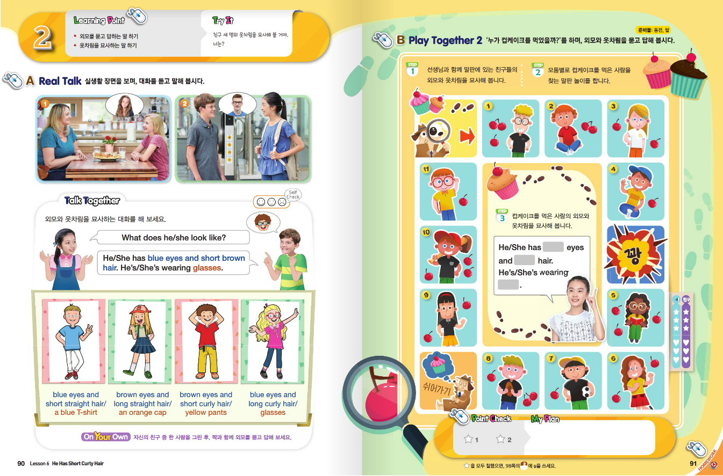

Slide 5
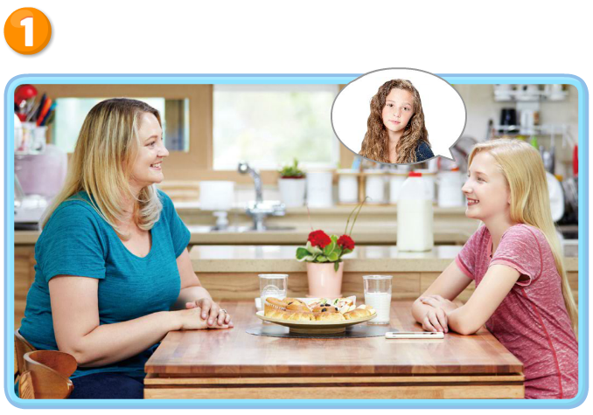
Real Talk Scene 1

Slide 6
Real Talk Scene 1 Let’s Listen

Slide 7
Real Talk Scene 1 Let’s Listen Again

Slide 8
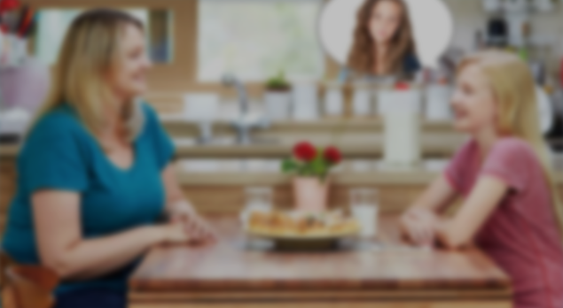
Listen and Comprehend
`
How was school today?
It was good.
Oh, we have a new student.
She’s very pretty.
Really? What does she look like?
She has blue eyes and long curly hair.
Oh, I have her picture.

Slide 9
Listen and Repeat
`
How was school today?
It was good.
Oh, we have a new student.
She’s very pretty.
Really? What does she look like?
She has blue eyes and long curly hair.
Oh, I have her picture.

Slide 10
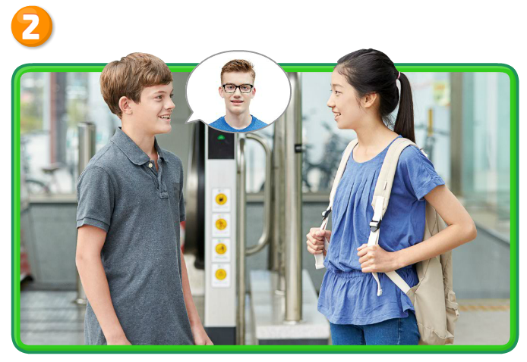
Real Talk Scene 2

Slide 11
Real Talk Scene 2 Let’s Listen

Slide 12
Real Talk Scene 2 Let’s Listen Again

Slide 13
Listen and Comprehend
`
Hi, Danny.
What are you doing here?
I’m waiting for my cousin.
We’re going to visit our grandparents.
What does he look like?

Slide 14
Listen and Comprehend
`
He has short brown hair.
He’s wearing glasses.
Is that your cousin?
Oh, yes!

Slide 15
Listen and Repeat
`
Hi, Danny.
What are you doing here?
I’m waiting for my cousin.
We’re going to visit our grandparents.
What does he look like?

Slide 16
Listen and Repeat
`
He has short brown hair.
He’s wearing glasses.
Is that your cousin?
Oh, yes!

Slide 17
Talk Together

Slide 18
Talk Together

Slide 19
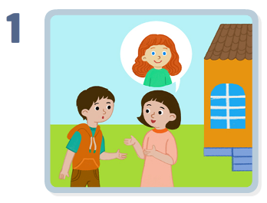
Point Check
What does she look like?
She has blue eyes and long curly hair.

Slide 20
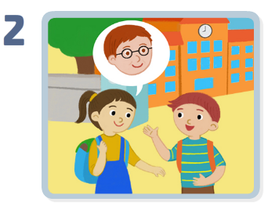
Point Check
What does he look like?
He has brown eyes and short straight hair.
He’s wearing glasses.

Slide 21
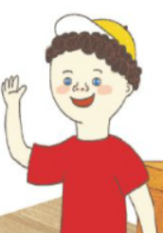
Let’s Review
What does he look like?
He has blue eyes and short curly hair.
He’s wearing a yellow cap.

Slide 22
Let’s Review

Slide 23
Your Work
Real Talk 따라 말하기
Talk Together에 제시된 낱말과 어구
공책에 적어보기

Slide 24
이 영상에 사용한 교과서의 지문, 삽화, 음원, 영상 등
모든 교과서 자료는 (주)천재교육에 저작재산권이 있습니다.
이 영상의 저작재산권은 제작자에게 있습니다
이 영상은 각 초등학교에서 수업에 사용할 수 있습니다.
이 외의 방법과 목적으로 이 영상을 사용하거나
일부 또는 전부를 저장 장치에 저장하거나,
일부 또는 전부를 다른 자료에 사용하는 것은
저작권법에 위배될 수 있음을 알려드립니다.

