Slide 1
2nd
Period
English Grade 6
Lesson 7
Lesson 7
How Often Do You Eat Breakfast?
(p110~111)

Slide 2
Let’s Review
Once,
twice,
three times a day
I brush my teeth
three times a day.
Once,
twice,
three times a week
I clean my room
three times a week.

Slide 3
Let’s Review Let’s Chant
Once,
twice,
three times a day
I brush my teeth
three times a day.
Once,
twice,
three times a week
I clean my room
three times a week.

Slide 4
Learning Point
빈도수를 묻고 답하는 말하기
칭찬하는 말하기

Slide 5
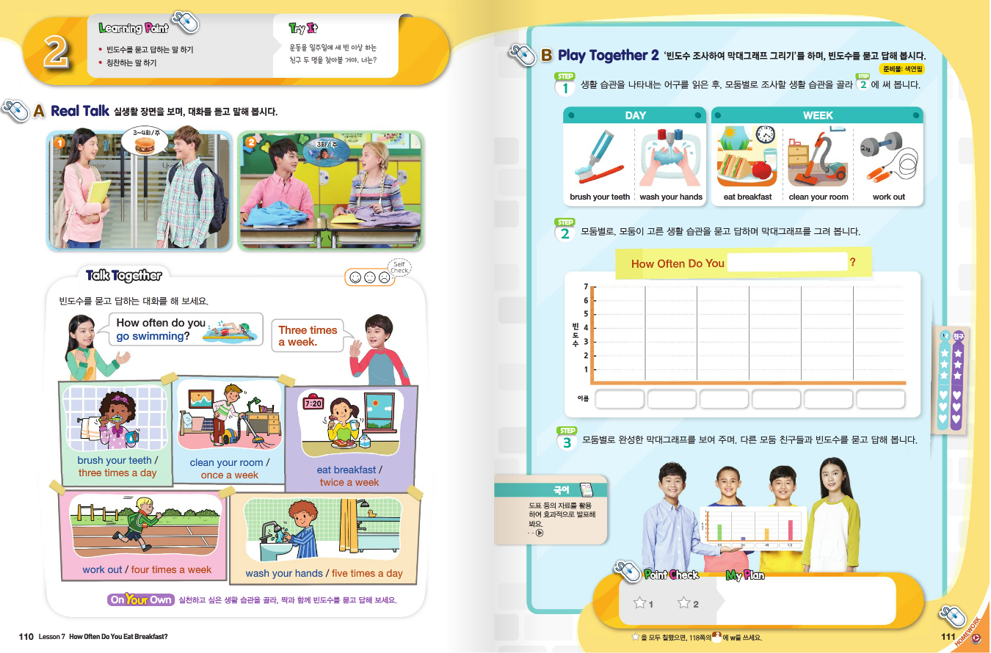

Slide 6
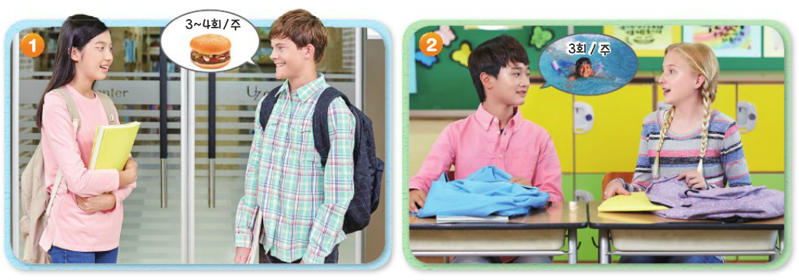
Real Talk Scene 1

Slide 7
Real Talk Scene 1 Let’s Listen

Slide 8
Real Talk Scene 1 Let’s Listen Again

Slide 9
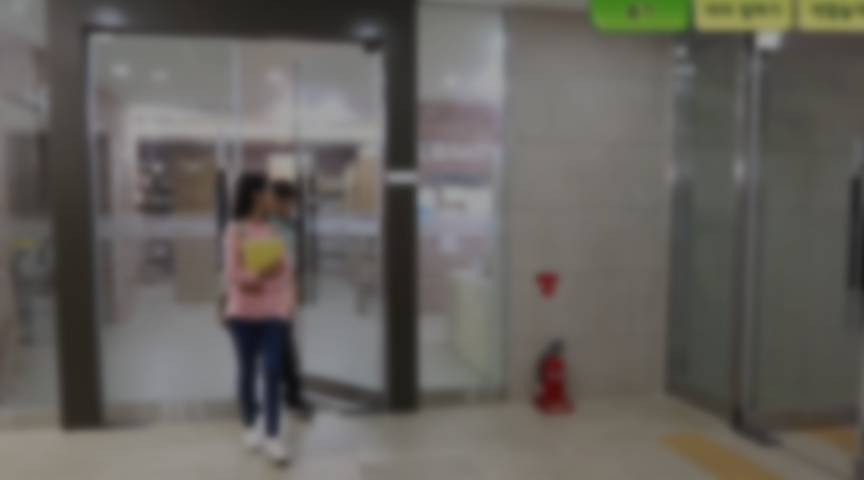
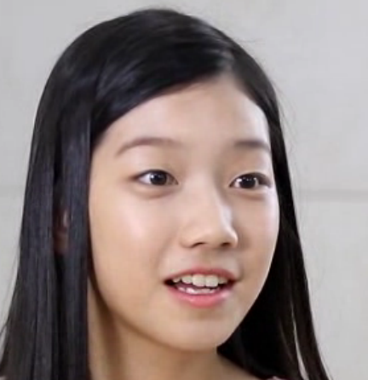
Listen and Comprehend
`
It's time for lunch.
What do you want, Danny?
How about hamburgers?
Again? How often do you eat fast food?

Slide 10
Listen and Comprehend
`
Three or four times a week.
That’s not good.
Eat healthy food more often.
Okay, I will.

Slide 11
Listen and Repeat
`
It's time for lunch.
What do you want, Danny?
How about hamburgers?
Again? How often do you eat fast food?

Slide 12
Listen and Repeat
`
Three or four times a week.
That’s not good.
Eat healthy food more often.
Okay, I will.

Slide 13
Real Talk Scene 2

Slide 14
Real Talk Scene 2 Let’s Listen

Slide 15
Real Talk Scene 2 Let’s Listen Again

Slide 16
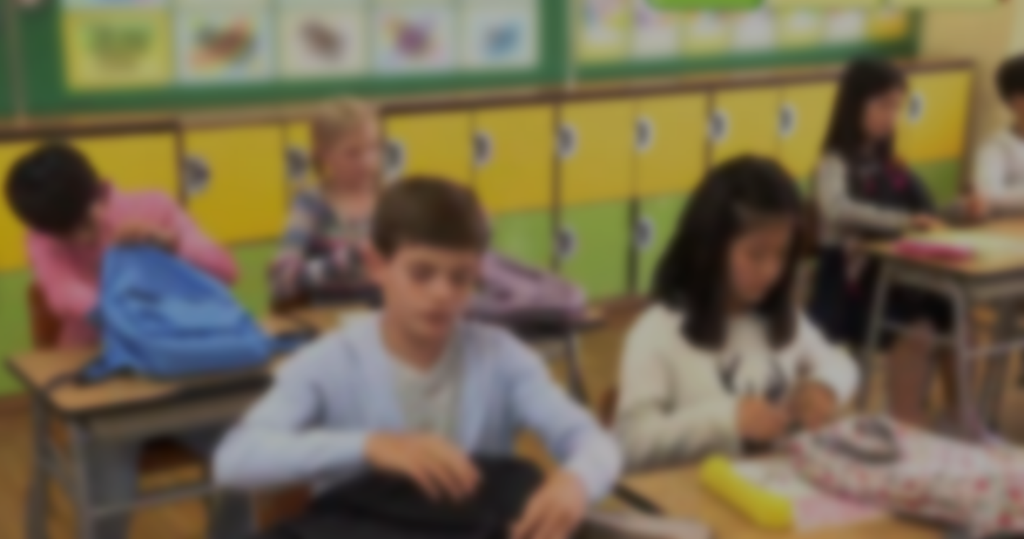
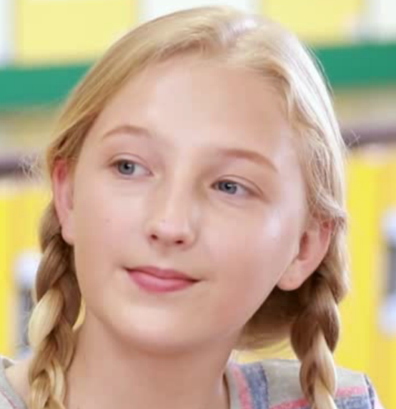
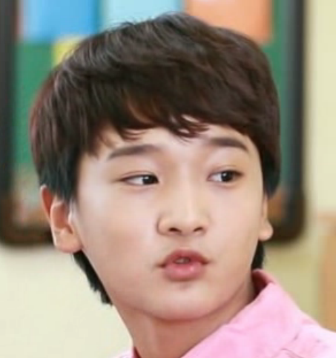
Listen and Comprehend
`
What will you do this afternoon, Junho?
I will go to swimming class.
How often do you go swimming?
Three times a week.

Slide 17
Listen and Comprehend
`
Good for you.
How about you?
I have a guitar lesson every day.

Slide 18
Listen and Repeat
`
What will you do this afternoon, Junho?
I will go to swimming class.
How often do you go swimming?
Three times a week.

Slide 19
Listen and Repeat
`
Good for you.
How about you?
I have a guitar lesson every day.

Slide 20
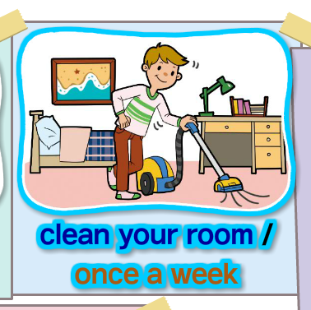
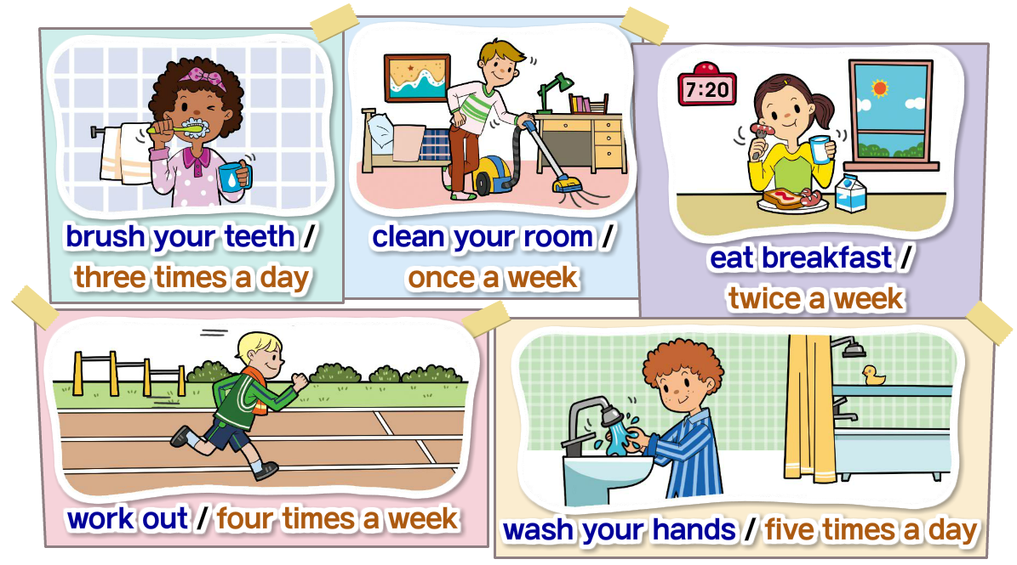
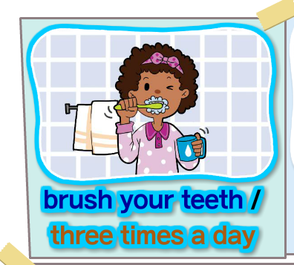
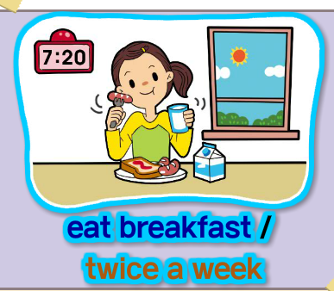
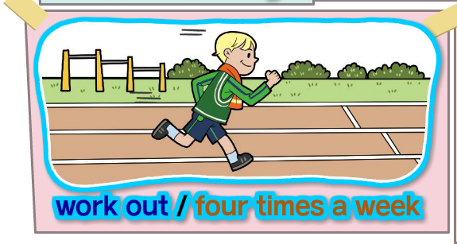
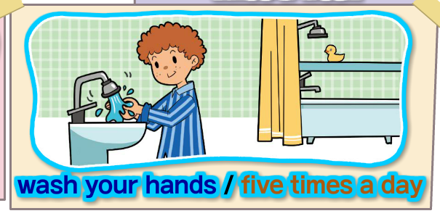
Talk Together

Slide 21
Talk Together

Slide 22
Talk Together

Slide 23
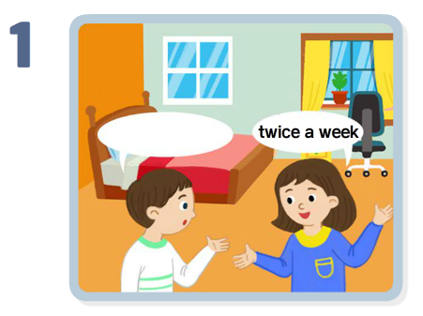
Point Check
How often do you clean your room?
Twice a week.

Slide 24
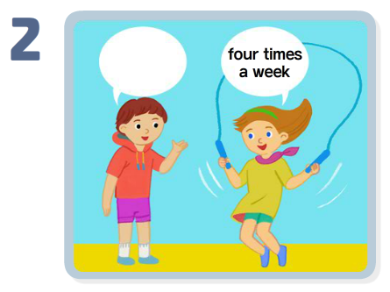
Point Check
How often do you work out?
Four times a week.
Good for you.

Slide 25
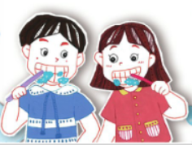
Let’s Review
How often do you brush your teeth?
I brush my teeth three times a day.

Slide 26
Let’s Review

Slide 27
Your Work
1
Real Talk 다시 듣고 따라 말하기
2
Talk Together에 제시된 어구
공책에 적어보기
3
영어 공부를 일주일에 몇 번 하는지 말하기

Slide 28
이 영상에 사용한 교과서의 지문, 삽화, 음원, 영상 등
모든 교과서 자료는 (주)천재교육에 저작재산권이 있습니다.
이 영상의 저작재산권은 제작자에게 있습니다
이 영상은 각 초등학교에서 수업에 사용할 수 있습니다.
이 외의 방법과 목적으로 이 영상을 사용하거나
일부 또는 전부를 저장 장치에 저장하거나,
일부 또는 전부를 다른 자료에 사용하는 것은
저작권법에 위배될 수 있음을 알려드립니다.

